Slide 1
Fall, 2021
Lecture 05: Integration

Slide 2
Contents
1
Anti-derivative & Indefinite Integration
2
Integration by substitution
3
Area & definite Integration
4
The fundamental theorem of calculus
5
Evaluate definite Integration
6
Average value and its applications

Slide 3
TWO HISTORICAL PROBLEMS OF CALCULUS

Slide 4
Two historical problems of calculus
Historically, the development of calculus by Isaac Newton and Gottfried W. Leibniz resulted from the investigation of the following problems:
Finding the tangent line to a curve at a given point on the curve:
y
T
t

Slide 5
Two historical problems of calculus
Historically, the development of calculus by Isaac Newton and Gottfried W. Leibniz resulted from the investigation of the following problems:
Finding the area of planar region bounded by an arbitrary curve.
y
R
x

Slide 6
Two historical problems of calculus
The study of the tangent-line problem led to the creation of differential calculus, which relies on the concept of the derivative of a function.
The study of the area problem led to the creation of integral calculus, which relies on the concept of the anti-derivative, or integral, of a function.

Slide 7
Anti-derivative & Indefinite Integration

Slide 8
Anti-derivative
Recall the speeding train problem discussed in lecture 3.
The question asked then was:
If we know the position of the train at any time t, can we find its velocity at that time?
The position was described by f(t), and the velocity by f ′(t).
Now, in this lecture we will consider precisely the opposite problem:
If we know the velocity of the maglev at any time t, can we find its position at that time?
That is, knowing its velocity function f ′(t), can we find its position function f(t)?

Slide 9
Anti-derivative
To solve this kind of problems, we need the concept of the antiderivative of a function.
Antiderivatie definition: A function F is an antiderivative of f on an interval I if F ′(x) = f(x) for all of x in I.
Theorem 1: Let G be an antiderivative of a function f.
Then, every antiderivative F of f must be of the form
F(x) = G(x) + C
where C is a constant.

Slide 10
Anti-derivative: Example
Prove that the function G(x) = x² is an antiderivative of the function f(x) = 2x.
Write a general expression for the antiderivatives of f.
Solution
Since G′(x) = 2x = f(x), we have shown that G(x) = x² is an antiderivative of f(x) = 2x.
By Theorem 1, every antiderivative of the function f(x) = 2x has the form F(x) = x² + C, where C is a constant.

Slide 11
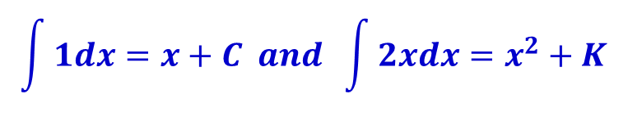
Indefinite Integral
The process of finding all the antiderivatives of a function is called antidifferentiation or integration.
We use the symbol ∫, called an integral sign, to indicate that the operation of integration is to be performed on some function f.
Thus,
where C and K are arbitrary constants.
$$\int{1dx}=x+C and \int{2xdx}=x^{2}+K$$

Slide 12
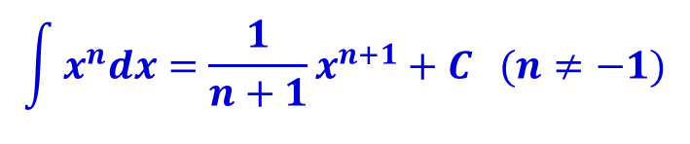
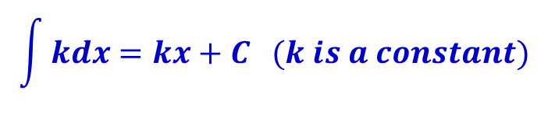
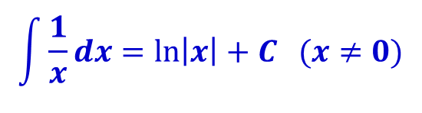
Integration rules and formulas
Rule 1: The Indefinite Integral of a Constant
$$\int{kdx}=kx+C (k is a constant)$$
Rule 2: The Power rule
$$\int{x^{n}dx}=\frac{1}{n+1}x^{n+1}+C (n≠−1)$$
$$\int{\frac{1}{x}dx}=\ln\left|x\right|+C (x≠0)$$

Slide 13
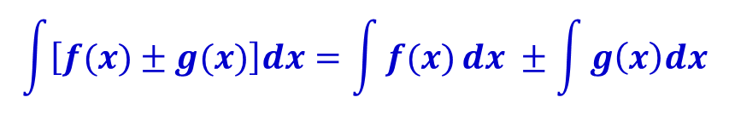
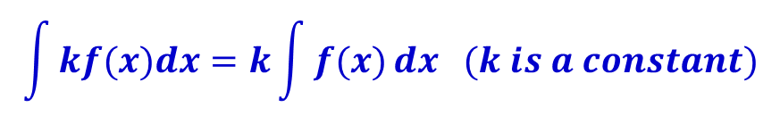
Integration rules and formulas
Rule 3: The Indefinite Integral of a Constant Multiple of a Function
$$\int{kf(x)dx}=k\int{f(x)}dx (k is a constant)$$
Rule 4: The Sum rule
$$\int{\left[f(x)±g(x)\right]dx}=\int{f(x)}dx ±\int{g\left(x\right)dx}$$

Slide 14


Integration rules and formulas
Rule 5: The Indefinite Integral of the Exponential Function
$$\int{e^{x}dx}=e^{x}+C$$
$$\int{b^{x}dx}=\frac{b^{x}}{\ln{b}}+C$$

Slide 15
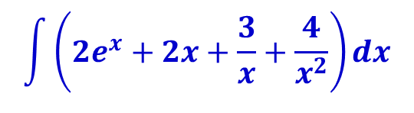
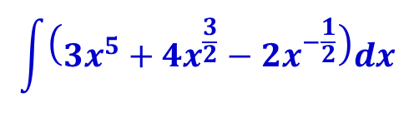
Indefinite Integral: Example
Find the indefinite integral:
a)
b)
$$\int{\left({3x}^{5}+{4x}^{\frac{3}{2}}−{2x}^{−\frac{1}{2}}\right)dx}$$
$$\int{\left(2e^{x}+2x+\frac{3}{x}+\frac{4}{x^{2}}\right)dx}$$

Slide 16

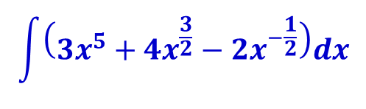
Indefinite Integral: Example
Solution:
a)
$$\int{\left({3x}^{5}+{4x}^{\frac{3}{2}}−{2x}^{−\frac{1}{2}}\right)dx}$$
$$\int{\left({3x}^{5}+{4x}^{\frac{3}{2}}−{2x}^{−\frac{1}{2}}\right)dx}=3\int{x^{5}dx}+4\int{x^{\frac{3}{2}}}dx−2\int{x^{−\frac{1}{2}}}dx$$
$$=3\left(\frac{1}{6}\right)x^{6}+4\left(\frac{2}{5}\right)x^{\frac{5}{2}}−2\left(2\right)x^{\frac{1}{2}}+C$$
$$=\frac{1}{2}x^{6}+\frac{8}{5}x^{\frac{5}{2}}−4x^{\frac{1}{2}}+C$$

Slide 17
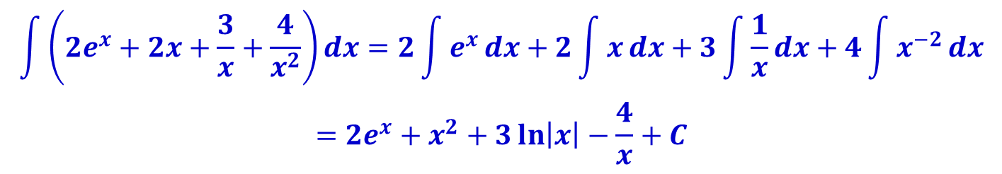
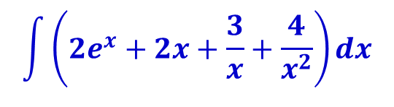
Indefinite Integral: Example
Solution:
b)
$$\int{\left(2e^{x}+2x+\frac{3}{x}+\frac{4}{x^{2}}\right)dx}$$
$$\int{\left(2e^{x}+2x+\frac{3}{x}+\frac{4}{x^{2}}\right)dx}=2\int{e^{x}}dx+2\int{x}dx+3\int{\frac{1}{x}}dx+4\int{x^{−2}}dx$$
$$=2e^{x}+x^{2}+3\ln\left|x\right|−\frac{4}{x}+C$$

Slide 18
Integration by substitution

Slide 19

Integration by substitution method
The method of substitution is related to the chain rule for differentiating functions.
It is a powerful tool for integrating a large class of functions.
Consider the indefinite integral
One way to solve this integral is to expand the expression and integrate the resulting integrand term by term.
An alternative approach simplifies the integral by making a change of variable.
Write u = 2x + 4
with differential du = 2dx
$$\int{2{\left(2x+4\right)}^{5}dx}$$

Slide 20

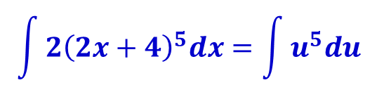
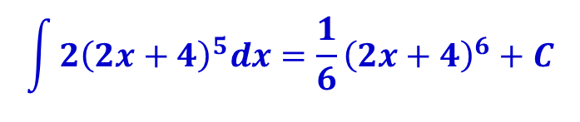
Integration by substitution method
Substitute u = 2x + 4 and du = 2dx in the original expression:
Now it’s easy to integrate:
Replacing u by u = 2x + 4, we obtain:
$$\int{2{\left(2x+4\right)}^{5}dx}=\int{u^{5}du}$$
$$\int{u^{5}du}=\frac{1}{6}u^{6}+C$$
$$\int{2{\left(2x+4\right)}^{5}dx}=\frac{1}{6}{\left(2x+4\right)}^{6}+C$$

Slide 21
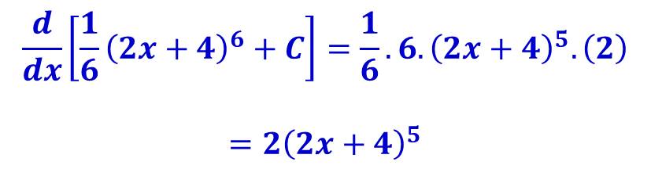
Integration by substitution method
We can verify the result by finding its derivative:
The derivative is indeed the original integrand expression.
$$\frac{d}{dx}\left[\frac{1}{6}{\left(2x+4\right)}^{6}+C\right]=\frac{1}{6}.6.{\left(2x+4\right)}^{5}.\left(2\right)$$
$$=2{\left(2x+4\right)}^{5}$$

Slide 22
Integration by substitution method
Steps of Integration by substitution.
Step 1 Let u = g(x), where g(x) is part of the integrand, usually the “inside function” of the composite function f(g(x)).
Step 2 Find du = g′(x)dx.
Step 3 Use the substitution u = g(x) and du = g′(x)dx to convert the entire integral into one involving only u.
Step 4 Evaluate the resulting integrand.
Step 5 Replace u by g(x) to obtain the final solution as a function of x.

Slide 23





Integration by substitution method: Example
Find
Solution:
Step 1: The integrand involves the composite function with the “inside function” so we choose
Step 2: We evaluate du/dx
$$\int{2x{\left(x^{2}+3\right)}^{4}dx}$$
$${\left(x^{2}+3\right)}^{4}$$
$$g\left(x\right)=x^{2}+3$$
$$u=x^{2}+3$$
$$du=g^{′}\left(x\right)dx=2xdx$$

Slide 24

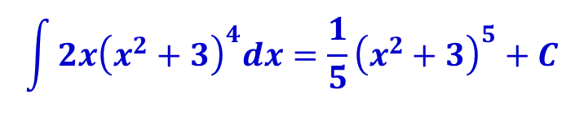

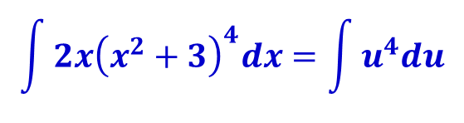

Integration by substitution method: Example
Find
Solution:
Step 3: Substitute and to obtain
Step 4: We evaluate the integral
Step 5: Replace u by x² + 3 to find the solution:
$$\int{2x{\left(x^{2}+3\right)}^{4}dx}$$
$$u=x^{2}+3$$
$$du=2xdx$$
$$\int{2x{\left(x^{2}+3\right)}^{4}dx}=\int{u^{4}du}$$
$$\int{u^{4}du}=\frac{1}{5}u^{5}+C$$
$$\int{2x{\left(x^{2}+3\right)}^{4}dx}=\frac{1}{5}{\left(x^{2}+3\right)}^{5}+C$$

Slide 25
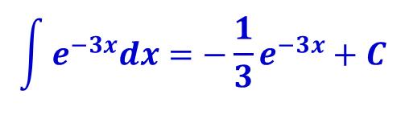

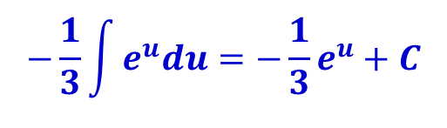

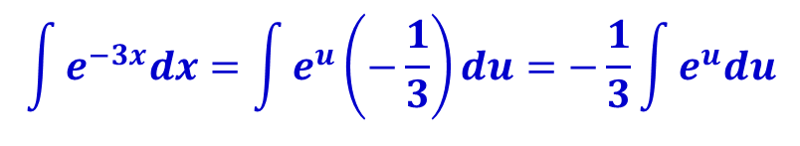


Integration by substitution method: Example
Find
Solution:
Let , so that , or
Substitute to express the integrand in terms of u:
Evaluate the integral:
Replace u by –3x to find the solution:
$$\int{e^{−3x}dx}$$
$$dx=−\frac{1}{3}du$$
$$u=−3x$$
$$du=−3dx$$
$$\int{e^{−3x}dx}=\int{e^{u}\left(−\frac{1}{3}\right)du}=−\frac{1}{3}\int{e^{u}du}$$
$$−\frac{1}{3}\int{e^{u}du}=−\frac{1}{3}e^{u}+C$$
$$\int{e^{−3x}dx}=−\frac{1}{3}e^{−3x}+C$$

Slide 26
Area and the Definite Integral

Slide 27
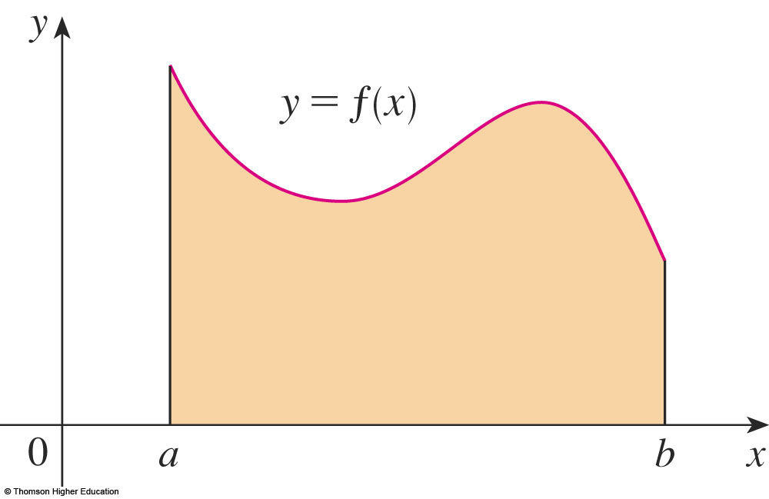

The Area under the graph of a function
Consider the area under the curve y = f(x) from a to b
We use the rectangle method to approximate this area
Divide the interval [a, b] in to n equal subintervals by inserting n−1 equally spaced points between a and b, and denote those points by x1, x2,..., xn−1
Over each subinterval construct a rectangle whose height is the value off at an arbitrarily selected point in the subinterval:
$$x_{1}^{∗},x_{2}^{∗},x_{3}^{∗}, …,x_{n}^{∗}$$

Slide 28
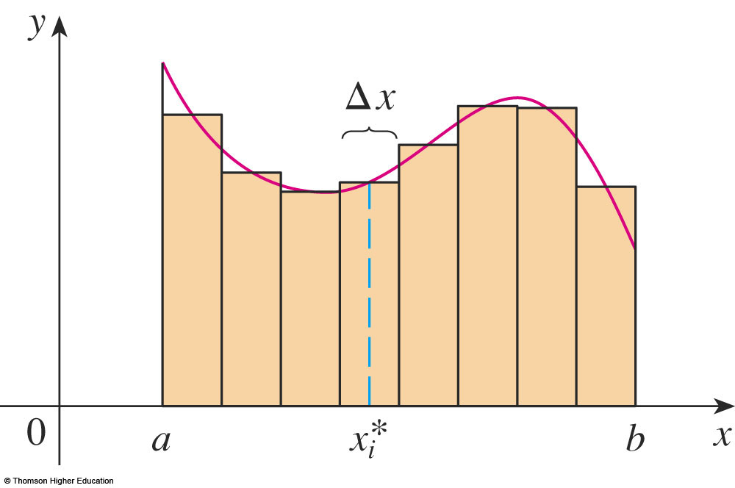

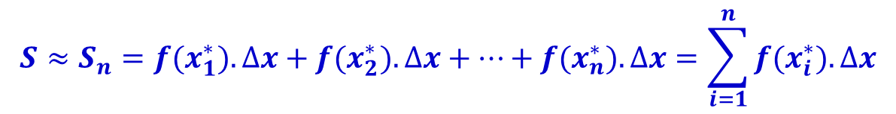

The Area under the graph of a function
Each of these subintervals has width (b−a)/n, which is customarily denoted by:
The area of the rectangles is denoted by
The union of the rectangles forms a region Sn whose area can be regarded as an approximation to the area S of the region under the graph; that is,
$$∆x=\frac{b−a}{n}$$
$$s_{i}={f(x}_{i}^{∗}).∆x$$
$$S≈S_{n}={f(x}_{1}^{∗}).∆x+{f(x}_{2}^{∗}).∆x+…+{f(x}_{n}^{∗}).∆x=\sum_{i=1}^{n}{{f(x}_{i}^{∗}).∆x}$$

Slide 29
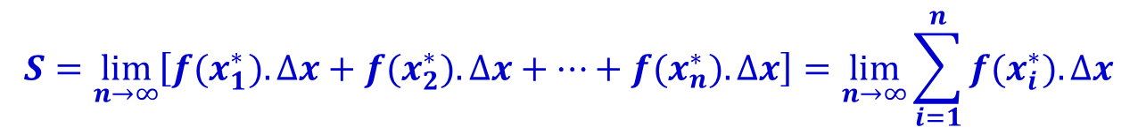
The Area under the graph of a function
Repeat the process above using more and more subdivisions, and define the area S to be the “limit” of the sum Sn as n increases without bound. That is, we define the area S as:
Let f be a nonnegative continuous function on [a, b]. Then, the area of the region under the graph of f is
where x₁, x₂, … , x_{n} are arbitrary points in the n subintervals of [a, b] of equal width Δx = (b – a)/n.
$$S=\lim_{n→∞}\left[{f(x}_{1}^{∗}).∆x+{f(x}_{2}^{∗}).∆x+…+{f(x}_{n}^{∗}).∆x\right]=\lim_{n→∞}{\sum_{i=1}^{n}{{f(x}_{i}^{∗}).∆x}}$$

Slide 30

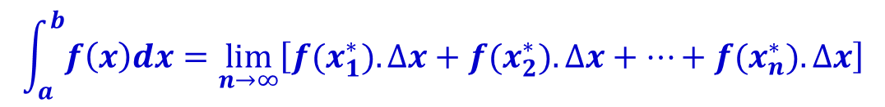
The definite integral
Let f be a nonnegative continuous function on [a, b]. If
exists for all choices of representative points x₁, x₂, … , x_{n} in the n subintervals of [a, b] of equal width Δx = (b – a)/n, then the limit is called the definite integral of f from a to b and is denoted by:
Thus,
The number a is the lower limit of integration, and the number b is the upper limit of integration.
$$\lim_{n→∞}\left[{f(x}_{1}^{∗}).∆x+{f(x}_{2}^{∗}).∆x+…+{f(x}_{n}^{∗}).∆x\right]$$
$$\int_{a}^{b}{f\left(x\right)dx}$$
$$\int_{a}^{b}{f\left(x\right)dx}=\lim_{n→∞}\left[{f(x}_{1}^{∗}).∆x+{f(x}_{2}^{∗}).∆x+…+{f(x}_{n}^{∗}).∆x\right]$$

Slide 31



Geometric Interpretation of the Definite Integral
If f is nonnegative and integrable on [a, b], then
is equal to the area of the region under the graph of f on [a, b].
$$\int_{a}^{b}{f\left(x\right)dx}$$
y
$$y=f(x)$$
$$S=\int_{a}^{b}{f\left(x\right)dx}$$
x
a
b

Slide 32

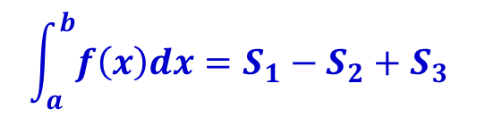
Geometric Interpretation of the Definite Integral
If f is nonnegative and integrable on [a, b], then
is equal to the area of the region above the x-axis minus the region below the axis on [a, b].
$$\int_{a}^{b}{f\left(x\right)dx}$$
y
$$\int_{a}^{b}{f\left(x\right)dx}=S_{1}−S_{2}+S_{3}$$
$$y=f(x)$$
S₁
S₃
x
a
b
S₂

Slide 33
The Fundamental Theorem of Calculus

Slide 34
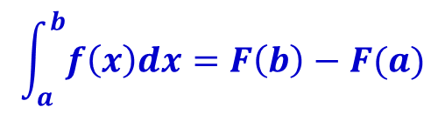
The Fundamental Theorem of Calculus
Let f be continuous on [a, b]. Then, where F is any antiderivative of f; that is, F ′(x) = f(x).
$$\int_{a}^{b}{f\left(x\right)dx}=F\left(b\right)−F(a)$$

Slide 35
The Fundamental Theorem of Calculus: Example
Find the area of the region under the graph of y = x² + 1 from x = –1 to x = 2.
Solution:
We notice that the graph is above x-axis.
y
f(x) = x² + 1
5
4
3
2
S
x
–2 –1 1 2

Slide 36
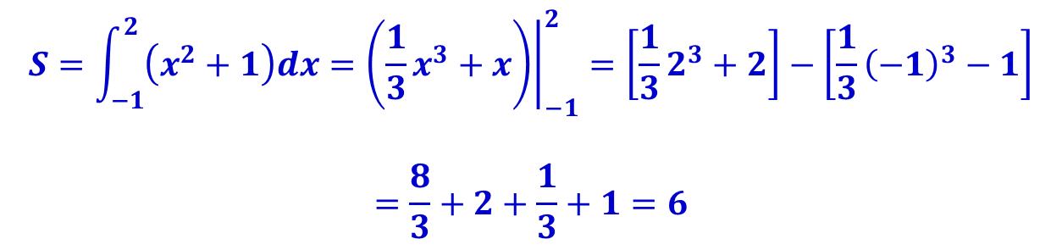
The Fundamental Theorem of Calculus: Example
Find the area of the region under the graph of y = x² + 1 from x = –1 to x = 2.
Solution:
We notice that the graph is above x-axis. Using the fundamental theorem of calculus, we find that the required area is
$$S=\int_{−1}^{2}{\left(x^{2}+1\right)dx={\left.\left(\frac{1}{3}x^{3}+x\right)\right|}_{−1}^{2}=\left[\frac{1}{3}2^{3}+2\right]−\left[\frac{1}{3}{\left(−1\right)}^{3}−1\right]}$$
$$=\frac{8}{3}+2+\frac{1}{3}+1=6$$

Slide 37
Evaluate definite Integration

Slide 38

Relationship between Definite and Indefinite Integral
Let f be continuous on [a, b]. Then,
$$\int_{a}^{b}{f\left(x\right)dx}={\left.\int{f\left(x\right)dx}\right]}_{a}^{b}$$
To evaluate a definite integral, first we evaluate the corresponding indefinite integral to find an antiderivative function F.
Then we evaluate F(b)-F(a).

Slide 39
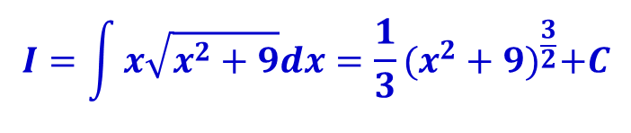



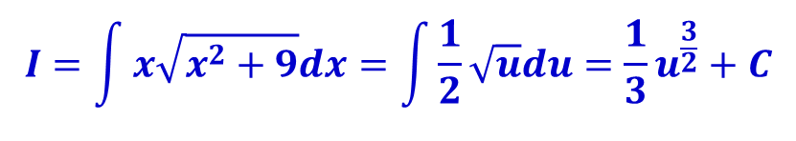


Evaluate definite integral: Example
Evaluate
Solution:
First, we find the indefinite integral:
Recall to substitution method. Let so that
Then, we have:
Now, replace u by to obtain final result
$$\int_{0}^{4}{x\sqrt{x^{2}+9}dx}$$
$$I=\int{x\sqrt{x^{2}+9}dx}$$
$$u=x^{2}+9$$
$$du=2xdx$$
$$I=\int{x\sqrt{x^{2}+9}dx}=\int{\frac{1}{2}\sqrt{u}du}=\frac{1}{3}u^{\frac{3}{2}}+C$$
$$u=x^{2}+9$$
$$I=\int{x\sqrt{x^{2}+9}dx}=\frac{1}{3}{(x^{2}+9)}^{\frac{3}{2}}+C$$

Slide 40
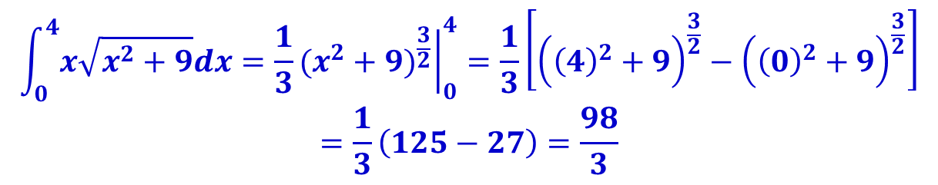
Evaluate definite integral: Example
Evaluate
Solution:
Using the results, we evaluate the definite integral:
$$\int_{0}^{4}{x\sqrt{x^{2}+9}dx}$$
$$\int_{0}^{4}{x\sqrt{x^{2}+9}dx}={\left.\frac{1}{3}{(x^{2}+9)}^{\frac{3}{2}}\right|}_{0}^{4}=\frac{1}{3}\left[{\left({\left(4\right)}^{2}+9\right)}^{\frac{3}{2}}−{\left({\left(0\right)}^{2}+9\right)}^{\frac{3}{2}}\right]$$
$$=\frac{1}{3}\left(125−27\right)=\frac{98}{3}$$

Slide 41
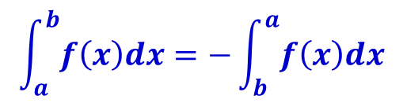

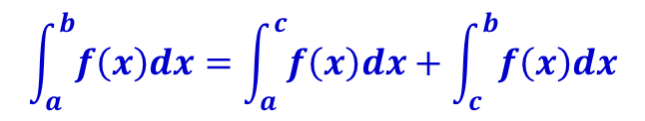
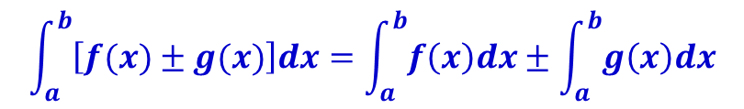

Properties of the Definite Integral
Let f and g be integrable functions, then
$$\int_{a}^{a}{f\left(x\right)dx}=0$$
$$\int_{a}^{b}{f\left(x\right)dx}=−\int_{b}^{a}{f\left(x\right)dx}$$
$$\int_{a}^{b}{cf\left(x\right)dx}=c\int_{a}^{b}{f\left(x\right)dx} (c is a constant)$$
$$\int_{a}^{b}{\left[f(x)±g(x)\right]dx}=\int_{a}^{b}{f\left(x\right)dx}±\int_{a}^{b}{g\left(x\right)dx}$$
$$\int_{a}^{b}{f\left(x\right)dx}=\int_{a}^{c}{f\left(x\right)dx}+\int_{c}^{b}{f\left(x\right)dx}$$

Slide 42




Evaluate definite integral: Example
Evaluate if
Solution:
We apply rule 5 to evaluate the integral
Evaluate:
$$\int_{0}^{3}{f(x)dx}$$
$$f(x)=\left\{\begin{aligned}x^{2}, x<2 \\ 3x−2, x≥2\end{aligned}\right.$$
$$I=\int_{0}^{3}{f(x)dx}=\int_{0}^{2}{f\left(x\right)dx+\int_{2}^{3}{f\left(x\right)dx}}=I_{1}+I_{2}$$
$$I_{1}=\int_{0}^{2}{f\left(x\right)dx}=\int_{0}^{2}{x^{2}dx={\left.\frac{1}{3}x^{3}\right|}_{0}^{2}}$$

Slide 43


Evaluate definite integral: Example
Evaluate if
Solution:
Evaluate:
Thus,
$$\int_{0}^{3}{f(x)dx}$$
$$f(x)=\left\{\begin{aligned}x^{2}, x<2 \\ 3x−2, x≥2\end{aligned}\right.$$
$$I_{2}=\int_{2}^{3}{f\left(x\right)dx}=\int_{2}^{3}{(3x−2)dx={\left.\left(\frac{3}{2}x^{2}−2x\right)\right|}_{2}^{3}}$$
$$I=I_{1}+I_{2}={\left.\frac{1}{3}x^{3}\right|}_{0}^{2}+{\left.\left(\frac{3}{2}x^{2}−2x\right)\right|}_{2}^{3}=\frac{49}{6}$$

Slide 44




Evaluate definite integral: Example
Find the total area between the curve and the x-axis over the interval [0,2]
Solution:
The graph of is sketched below
Note that the value of y is - positive in the interval [0,1] - negative in the interval [1,2]
The total area will be:
$$y=1−x^{2}$$
$$y=1−x^{2}$$
$$A=\int_{0}^{1}{(1−x^{2})dx}−\int_{1}^{2}{ \left(1−x^{2}\right)dx}$$
$$={\left.\left(x−\frac{x^{3}}{3}\right)\right|}_{0}^{1}−{\left.\left(x−\frac{x^{3}}{3}\right)\right|}_{1}^{2}=\frac{2}{3}−\left(−\frac{4}{3}\right)=2$$

Slide 45
Average value and its applications

Slide 46
Self Learning
Read textbook Chapter 5, Section 5.8 – (page 385-388).

Slide 47
Summary
Introduce the concept of integration and how to find the area under a curve.
Describe two integration types:
Indefinite integral
Definite integral
Different techniques for evaluating integrals are introduced
Basic integral rules
Substitution method
The fundamental theorem of calculus is described

Slide 48
Homework
Problem Set 6:
Read sections 5.2 - 5.6, 5.8 in Chapter 5. Test with some exercises at the end of each section (students should do as much as possible)
Read Study guide for topic 6.
All exercises in textbook page 408-412 (chapter 5 review exercise) – except the CAS exercises.
References
[1] H. Anton, I. Bivens, S. Davis, Calculus - Early Transcendentals, 9th Ed., MA, USA: John Wiley & Sons, Inc., 2009.

